Slide 1
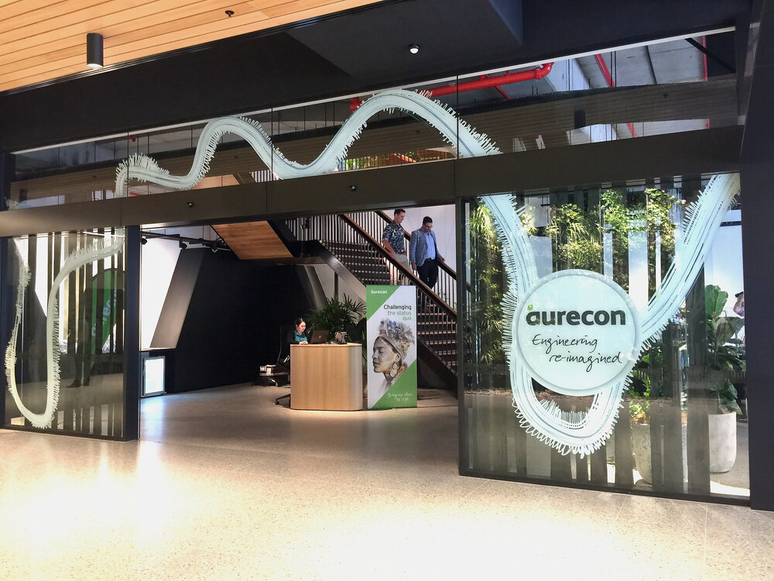
Generative AI
Video Summarization
Jefferson Lee
Data Science Consultant
Asset Management & Performance

Slide 2
What challenges are you looking to solve for you clients with Generative AI and are you actively engaged in conversations?
Main Usage:
Client Engagement (Keep up with the latest industry news)
The purpose of this project is to provide a summarization of daily news and market trends. It is hard to keep track of all the market news.
For example, Bloomberg TV publishes daily news:
Bloomberg Daybreak: Australia 03/01/2024 - 45mins
Bloomberg Daybreak: Asia 03/01/2024 - 48mins
Bloomberg Markets: The Close 02/29/2024 - 1hr 34mins
It is hard to keep track of everything, but this LLM tool can help summarize 1.5 hours of market news into 5 minutes of reading.
This also applies to understanding the background for the tender project, for example, it is important to understand the energy market while preparing the tender proposal in the coal industry.
Usage
Client Engagement
Generative AI Video Summarization

Slide 3
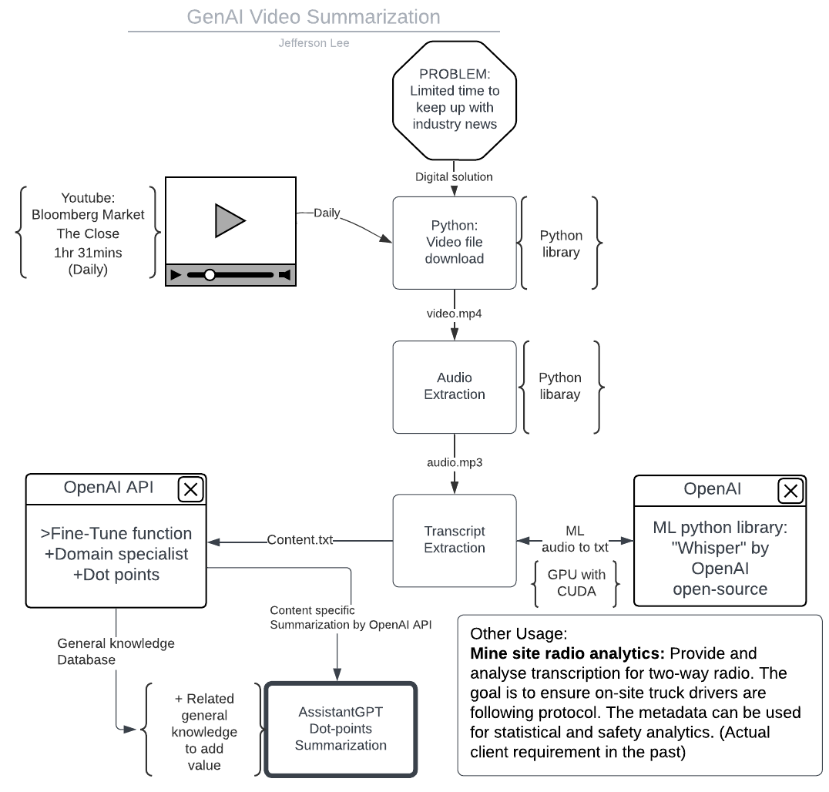
Flow Chart
Please have a look at the basic framework of this tool.
It includes several steps.
YouTube to Video
Video to Audio
Audio to Transcript
Transcript to OpenAI API
Assistant and Fine-tuned API
Summarization
Each of these sections can be used to solve other industry challenges.

Slide 4
What challenges are you looking to solve for you clients with Generative AI and are you actively engaged in conversations?
Other Usage:
Mine site radio analytics: Provide and analyse transcription for two-way radio. The goal is to ensure on-site truck drivers are following protocol. The metadata can be used for statistical and safety analytics. (Actual client requirement in the past)
Meeting agenda summarization: The technology can be extended to use in internal seminar summarization. For example, some colleagues missed KNOWing our Blueprint Series or had no time to watch the series due to working on the billable project. This summarization tool would be handy.
Industry
Actual Possible Use Case
Generative AI Video Summarization

Slide 5
What data or information have you been able to leverage with Generative AI?
The following information and resources have been leveraged in the project.
Bloomberg market news
Python library: moviepy
ML library: OpenAI whisper
OpenAI API Assistant API
Mp4 video source
Information
Leverage with GenAI
Generative AI Video Summarization

Slide 6
Have you delved into any specific Generative AI frameworks or tools? (If applicable, include links to code repositories, videos, or other websites that demonstrate what you've been working on)
This project dived into the OpenAI assistant feature and fine-tuning API, so API calls can provide suitable responses. Furthermore, tools like machine learning library “Whisper” (by OpenAI) and Pytorch (CUDA) are also utilized for the project.
The development of project 1, GenAI-Video-Summarization, is completed, so please refer to the following information.
Repositories: https://github.com/jjsk-project/GenAI-Video_Summarization.git
Code: In GitHub repositories.
Demo video: In GitHub repositories.
Flow chart: In GitHub repositories.
The project 2, GenAI-Market-Analyst, is still a work in progress. Please see Github for more info.
Tools
Actual Possible Use Case
Generative AI Video Summarization

Slide 7
Thank you!
For more information, please contact me.
Jefferson Lee
jefferson.lee@aurecongroup.com
Data Science Consultant
Asset Management & Performance

